Slide 1
Lower Susquehanna River Watershed Assessment
Watershed/Reservoir Sediment Management Literature Search
Preliminary Findings
Date: September 24, 2012
Anna Compton

Slide 2
Literature Search Purpose
Review, analyze, and synthesize literature on managing watershed/reservoir sedimentation.
Findings and lessons learned will be incorporated into refining sediment/nutrient management strategies for LSRWA.
Help us Brainstorm Ideas.

Slide 3
Methodology
Reviewed Sediment Task Force Findings
Conducted Database Literature Search
Findings
Trends
Conclusions

Slide 4
Sediment Task Force

Slide 5
Sediment Task Force Who were they?
Met from 1999 - 2001
Chaired by Susquehanna River Basin Commission
Multi-agency, Multijurisdictional group
Tasks:
Review of existing studies- Susquehanna sediment transport and storage;
Make recommendations on management options to address the issues;
Symposium of experts and policy makers; and
Recommend areas of study, research, or demonstration

Slide 6
Sediment Task Force Findings (Dec, 2000)
Human influenced sediment loading is a problem.
Loads in early 1900’s were 2-3 times larger (land use, BMP’s, dams).
Benefits of dams will be lost once at steady state:
Increased loads
More scouring
Steady State ~ 20 years???
Sediment transport is a natural process that has been aggravated by human activity. Management focus: reduce human impacts.
Notes:
Impairs streams, clogs culverts, bridges and other transportation-related structures, reduces recreational opportunities, stream bank erosion, and downstream flooding. Upper Chesa Bay impacted physically and biologically from delivered sediments. Impacts are exacerbated during storm events which scour additional sediment from behind the dams and result in a combined delivered sediment load which shocks the bay ecosystem.
4. Estimate based on current average fill rate and accounting for statistically expected scouring events.

Slide 7
Sediment Task Force Findings Cont’d (Dec, 2000)
Sediment transport - aggravated by catastrophic storm events.
Reducing loads to local streams, rivers and lakes has value.
Decreasing loads over time will restore water quality and habitats
Need more knowledge of sediment and effectiveness of management options to support a comprehensive management strategy.
Notes:
6. Actions are possible to address sediment for flow events of lesser magnitude. Implementation of management actions which help maintain sediment storage capacity behind the dams will benefit Bay;
7. Reducing sediments to local tribs will protect waterways and recreational opportunities they provide, maintain flood carrying capacity of stream channels and preserve agricultural lands;

Slide 8
Sediment Task Force Recommendations
Upland Management
Agriculture Uplands
Urban Uplands
Transportation Systems
Forestry
Mining Uplands
Reclaim/reforest abandoned mine land
Notes:
1. Agriculture - Reduce field soil loss and retain field losses at the edge of field before delivery to stream systems .
Promote clean water practices, educate, encourage partnerships, emphasize agricultural management plans that address enhanced sediment/nutrient management
2. Urban Minimize sediment disturbance, stabilize sediments as soon as possible, provide adequate erosion and sediment control measures for active construction projects, and maintain predevelopment runoff characteristics.
Increase awareness , promote non-structural BMP’s (rain gardens, disconnected roof, sheet flow, vegetative filters/channels,
3. Transportation Minimize sediment and road maintenance additives in roadway, railway and highway construction runoff .
Sediment and erosion control during construction, landscape-based stormwater management, ditch management, by minimizing exposed soil, stormwater and erosion control measures appropriate to road system types (dirt road, secondary, railways, etc.)
4. Forestry- Manage the forest soil as a unique ecosystem with great potential for reducing erosion when it is healthy.
Implement forest-harvesting BMP’s; encourage forest expansion, fund out reach programs.
The greater the amount of forested area in the Susquehanna River Basin, the greater the sediment holding capacity of undeveloped upland areas
5. Mining- Minimize the impacts that abandoned mine land (AML) has on receiving streams, and therefore, the Bay
AMLs also contribute other pollutants, including heavy metals and metal oxides that result in coatings on streambeds
Meet revegetation requirements, reforest AML’s., fund programs that reclaim AML’s.

Slide 9
Sediment Task Force Recommendations
Riverine Management
Stream Restoration & Stabilization
Sediment Trapping Structures (Impoundments/dams)
Sediment Transport Assessments (Monitoring and Modeling)
Stream Bank/Channel Stability Assessments (Monitoring and Modeling)
Riparian Buffers
Natural & Reconstructed Wetlands
Notes:
1. Stream restoration/stabilization- Significant sources of sediments are eroding from streambanks and the degradation of stream channels exacerbated by upland run-off. Implement projects through all existing and future programs, provide education materials, fund pilot projects, states and feds should be role models.
2. Sediment Trapping- Basin wide assessment of sediment trapping capability of multiple use water impoundment structures.
Create a database of multiple use dams and structures in the Basin and an evaluation of their relative value in sediment trapping and flow control.
3. Sediment Transport Assessments- Enhance sediment monitoring to support modeling of sediment sources, transport, and watershed sediment yield (delivery). Info to help identify where sediment delivery is from erosion from overland sources or remobilization of stream corridor source areas.
4. Basin wide, uniform monitoring of stream channel stability and stream bank conditions to understand the conditions of the riparian zone as a source of sediment. Produce a database of riparian conditions .
5. Riparian Buffers- Increase buffer width, to maximize sediment retention and mitigate storm flows.
Increase stream miles with buffers, build for long-term (e.g. woody plants), build to be sustainable, integrate with natural landscape.
6. Wetlands- Increase the wetland acreage (especially in the flood plains)
Continue “no net loss” philosophy
Integrate riparian buffers and wetlands in floodplains.

Slide 10
Sediment Task Force Recommendations
Reservoir Management
Sediment Bypassing: Would result in a base load condition that exceeds the current base load into the Bay. Counter to the currently accepted goal of reducing sediment input to the Bay.
Sediment Fixing: Would not mitigate scouring or change the amount of sediment passing through the system or add capacity.
Modified Dam operations: Unclear if this would accomplish anything in the interest of sediment control other than as a form of bypassing.
Dredging: Supports study to maintain/increase trapping capacity.
Notes:
Preserves the reservoir’s ability to trap sediment as it is carried downstream, and if possible, to reduce the volume of sediment that is available for transport during high-flow episodic events.
Bypassing-Pass sediments through the dams during less critical (non-storm, flow) periods so that the reservoirs maintain storage capacity for high-sediment transport storm events. This lessens the amount of sediment passed during these storm events. Would not greatly mitigate the effects of catastrophic storm events in which the flow is sufficient to scour in situ material and cause the net transport of sediment past the dams to be greater than the sediment load that the river carries into the dams.
Sediment Fixing- Placing clean dredged material over contaminated material so that the contaminated sediment is rendered harmless to nearby benthic communities.

Slide 11
Database Literature Search

Slide 12
Research Databases Used
Google Scholar
The Wall Street Journal
ProQuest
Academic Search Premier (EBSCO)
ScienceDirect
GreenFile (EBSCO)
EnvironetBASE
Agricola
GEOBASE

Slide 13
Literature Search Findings
100+ articles (National and International) were reviewed
A sub-set were determined to be most relevant to sediment management and were summarized:
Studies/Modeling
Technology
Alternative Analysis
Recommendations
Implemented Actions

Slide 14
Lit Search Themes, Findings, Conclusions
Reservoir sedimentation (declining storage) is a worldwide problem.
Trends like climate change and population growth are exacerbating problem.
Comprehensive, long-term sediment management is needed EVERYWHERE.
New dams, have sediment management built in.
Notes:
Climate change-scientists think it increases frequency and severity of storms, worsening erosion; more sediments
Population growth- land use changes more impervious surface, more sediments plus more demands on the use/need for dams and what they provide, water, irrigation
Not many new dams being constructed; however new ones are building in sediment management to maintain reservoir capacity.

Slide 15
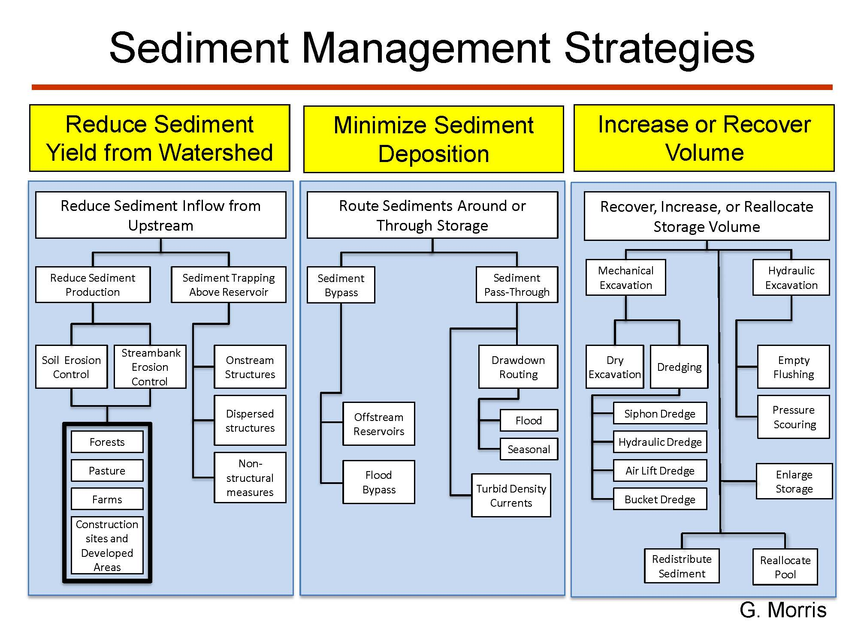
Lit Search Themes, Findings, Conclusions
Notes:
Reduce Sediment Yield from watershed-Prevent Erosion or Trap eroded sediment before it reaches reservoir.
-Sediment Pass through - Lower reservoir level during floods to increase flow velocity and minimize sediment deposition.
Trapping Sediment: Maintain high water level, low velocity, efficient sediment trapping .
Passing Sediment: Low water level, high velocity, maximize sediment pass-through. Coarse sediment may continue to be trapped while fine sediment is transported through the reservoir
-Sediment By-Pass- Pass coarse sediment around the dam by tunnel
-Off stream reservoir - Bypass significant floods around the storage pool
-Reservoir flushing- Reservoir level remains high with low level gate open –Useful to remove sediment from vicinity of an intake
- Empty Flushing -–Completely empty reservoir –Can remove large sediment volumes from entire reservoir –Flushing periods typically last from several days to several weeks
- Pressure Flushing- Scour zone created by opening the bottom outlet while reservoir level remains high
Flushing typically cannot transport all sediment sizes - Coarse sediment continue to accumulate in the delta
-Siphon dredge uses hydraulic head in reservoir to discharge sediment instead of using pump. Limited to special situations, near reservoir
Releasing turbidity currents by strategically opening the bottom sluice gates to pass highly concentrated flows through the reservoir presents the best possibility to release sediment downstream with minimal effect to operations and in line with the downstream environmental objectives. Fine sediments are usually transported by turbid density currents, and can focus fine sediment deposits at the dam. Predominate mechanism for fine sediment transport and deposition in deep reservoirs

Slide 16
Lit Search Themes, Findings, Conclusions
Goals - What is driving the need for sediment management drives the solution:
Losing purpose/function of the dam (economics)?
Restoring natural sediment flow (environmental)?
It’s all about the sediment -
Where they are coming from?
Where they are depositing?
Sediment size and chemical characterization?
Contaminants; land-use history?
Erodability rate
Location and magnitude of sediment deposition downstream?
Value of sediments behind the dam?
Precipitation patterns: when is sediment transported?

Slide 17
Lit Search Themes, Findings, Conclusions
Effectiveness - How effective is strategy at improving sedimentation?
Economic -
Capital costs for strategy?
Future operation and maintenance requirements?
Optimization/Adaptive Management -
Modeling before implementation
Monitor effects after implementation
Adjust activities to optimize effectiveness
Continuously improve system performance

Slide 18
Lit Search Themes, Findings, Conclusions
Environmental -
Permitting requirements?
Impacts?
Schedule -
How much time is required for solution to be implemented?
Long-term problems often need long-term solutions.
Implementation sequence: long and short-term implementation?
Integrated sediment system management-
Multi-faceted problem requires multi-faceted solution; most have combinations.
Benefits -
Costs incurred worthwhile?
Notes:
Environmental- The loss of sediment downstream from the dam can result in channel and tributary degradation and changes in benthic and aquatic habitats to those more suited to a clearer water discharge.
Benefits- in terms of extending the productive life of a dam? Is it economical to extend the life of a dam indefinitely?

Slide 19
Lit Search Themes, Findings, Conclusions
Dredging (i.e. increasing or recovering volume)
Operations and Maintenance
Contamination
Dredging can be reduced by using BMP’s and finding the critical sediment producing watersheds from upstream.
Tactical Dredging
Beneficial re-use
Soil amendments (agriculture, mining etc.)
Habitat development/beach nourishment
Commercial (bricks, geotextile container fill groins, landfill capping, tiles, glass, cement blocks
Dredging is very expensive normally is a last resort; often creates new social and environmental problems
Notes:
-

Slide 20
Lit Search Themes, Findings, Conclusions
By-passing - Routing sediments around or through storage
The technology to by-pass and transport sediments has been developed
Long Distance Conveyance hydraulic transport of through pipelines (>10 miles)
Hydrosuction sediment removal
Dredging equipment with hydrostatic head over a dam to create suction at the upstream end.
Difference between water levels upstream and downstream of dam to remove sediment through a floating or submerged pipeline.
Hydrosuction dredging, deposited sediment dredged and transported downstream or to a treatment basin.
Hydrosuction bypassing, incoming sediment is transported without deposition past the dam to the downstream receiving stream.
Notes:
Long Distance Conveyance- Louisiana coastal projects

Slide 21
Lit Search Themes, Findings, Conclusions
By-passing Continued
Pipeline diameter selection, and head size
Environmental Impacts
Increased turbidity levels downstream?
Changes in water chemistry?
Impacts of sediment-removal upstream?
Regulatory agencies contacted early
Upper limit of sediment concentration defined
Ecological aspects
Operational aspects
Out-flowing sediment concentration regularly monitored and controlled.
Notes:
Long Distance Conveyance- Louisiana coastal projects

Slide 22
LSRWA Goals and Objectives
Evaluate strategies to manage sediment and associated nutrient delivery to the Chesapeake Bay.
Strategies will incorporate input from Maryland, New York, and Pennsylvania Total Maximum Daily Load (TMDL) Watershed Implementation Plans.
Strategies will incorporate evaluations of sediment storage capacity at the three hydroelectric dams on the Lower Susquehanna River.
Strategies will evaluate types of sediment delivered and associated effects on the Chesapeake Bay.
Evaluate strategies to manage sediment and associated nutrients available for transport during high flow storm events to reduce impacts to the Chesapeake Bay.
3. Determine the effects to the Chesapeake Bay due to the loss of sediment and nutrient storage behind the hydroelectric dams on the Lower Susquehanna River.

