Slide 1
Energy Storage Study
PPRAC Meeting
May 17, 2017

Slide 2
Agenda
The Rise of Storage
HB 773 / SB 715 Overview
PPRAC’s Role

Slide 3
The rise of storage

Slide 4
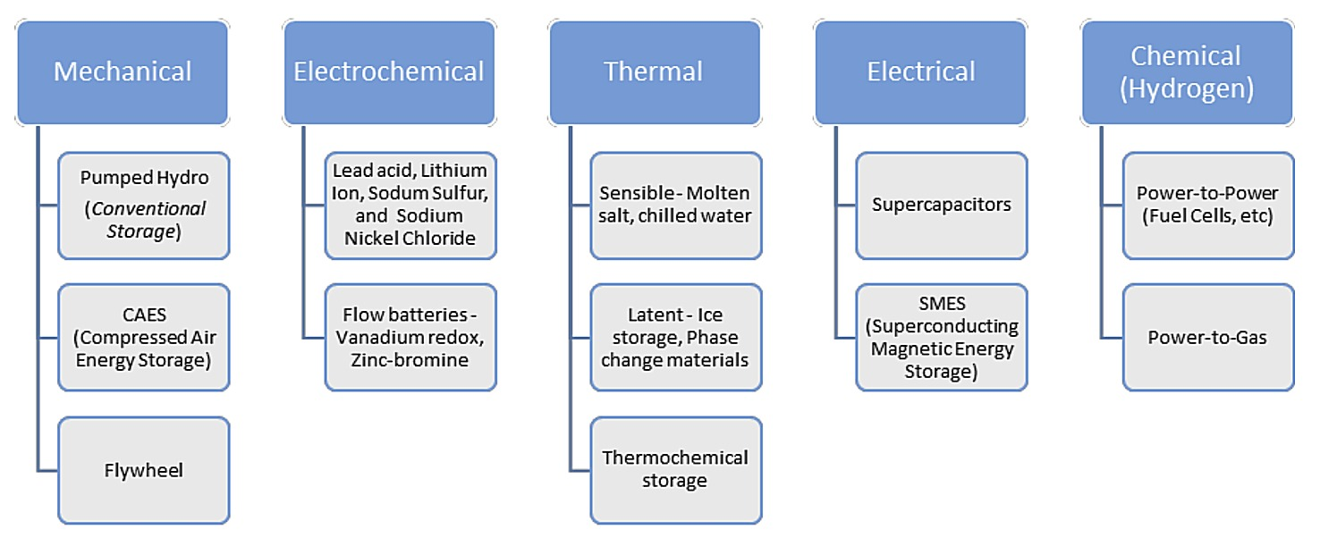
Types of Storage
Pumped hydro is often referred to as “conventional storage”
Newer, more flexible technologies can be dispatched within seconds
Source: State of Charge: Massachusetts Energy Storage Initiative Study

Slide 5
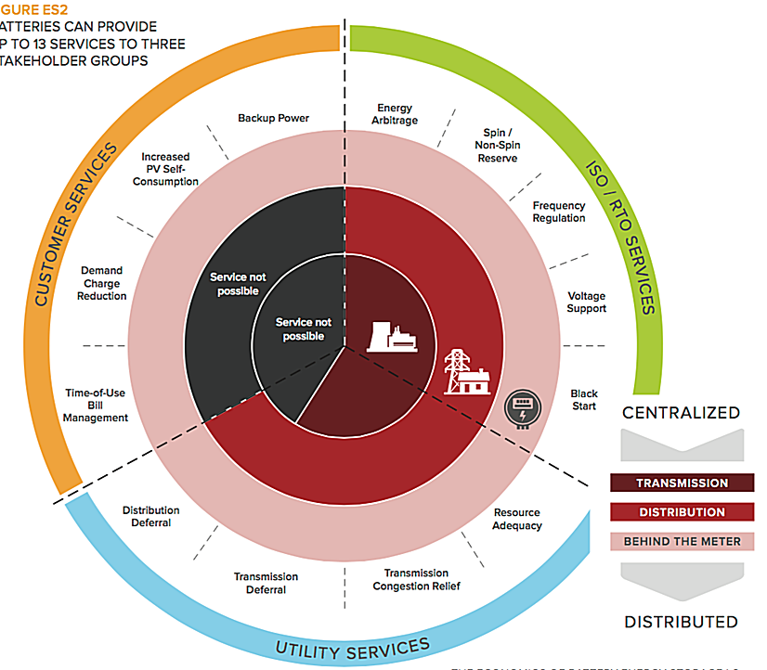
Services Provided
Storage can add value to the grid at three different levels
The same storage system can potentially provide services to different stakeholders at different times
Services that Batteries Can Provide
Source: Rocky Mountain Institute

Slide 6
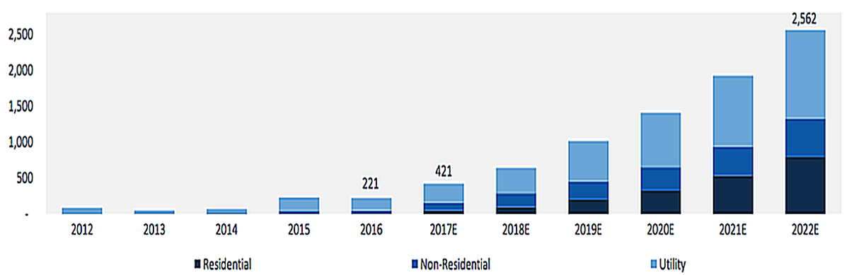
Growth Trends
Annual deployments of energy storage in the U.S. are forecasted to reach 2.6 GW by 2022
Energy Storage Deployments by Segment (MW)
Source: GTM Research

Slide 7
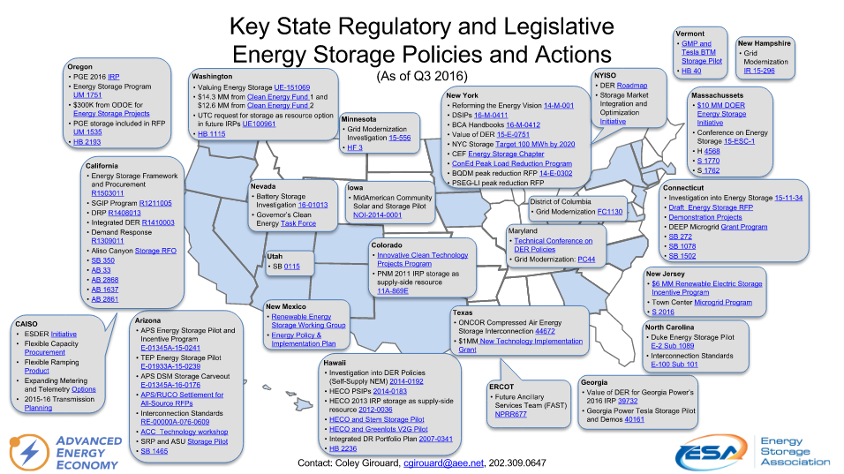
Regulatory Action
Throughout the U.S., states are considering ways to spur energy storage growth
U.S. Annual Energy Storage Deployment Forecast, 2012-2022E (MW)
Energy Storage Deployments by Segment (MW)
Source: The Energy Collective

Slide 8
PC 44
MD PSC launched Public Conference 44 (PC 44) in 2016 to explore seven grid-modernization topics
Goals for storage subgroup:
  Develop proposed regulations for Commission consideration defining and classifying residential energy storage and addressing related issues
  Develop proposals for energy storage as a utility asset on the distribution grid by considering issues such as cost allocation and utility cost recovery

Slide 9
HB 773 / SB 715 energy storage technology act

Slide 10
Purpose
“PPRP shall conduct a study to determine what regulatory reforms and market incentives are necessary or beneficial to increase the use of energy storage devices in the State in a manner that is fair and open to all stakeholders.”
Report due December 1, 2018 to:
  Senate Finance Committee
  Senate Budget and Taxation Committee
  House Economic Matters Committee
  House Appropriations Committee

Slide 11
Subjects to be Addressed
  1. The types and viability of different energy storage technologies and cases for their use
  2. Wholesale market factors, including available information from PJM and the Federal Energy Regulatory Commission

Slide 12
Subjects to be Addressed
  3. Regulatory policies, ownership models, cost recovery mechanisms, procurement targets, and market incentives in other states
  4. Policy–related barriers that restrict the ability to capture all of the societal benefits of energy storage

Slide 13
Subjects to be Addressed
  5. Cost recovery mechanisms, including cost recovery through electric distribution rates
  6. The efficient and timely approval of interconnection of energy storage systems owned by an electric company, a customer, or a third party

Slide 14
Subjects to be Addressed
  7. Whether and how pumped hydropower should be included in any regulatory policies or market incentives
  8. Incentivizing both behind-the-meter energy storage systems and systems directly connected to transmission and distribution facilities

Slide 15
Subjects to be Addressed
  9. Appropriate metrics and standards such as energy capacity, charge and discharge rates, round trip efficiency, and durability
  10. Policies, procurement targets, or other market incentives that would allow for diverse ownership models

Slide 16
PPRAC’s ROLE

Slide 17
Stakeholder Input
In conducting the study required under this section, PPRP shall consult with:*
  The Public Service Commission;
  The Office of People’s Counsel
  The Maryland Energy Administration;
  Environmental organizations;
  Electric companies;
  Third-party providers of energy storage devices;
  Associations of third-party providers;
  The University of Maryland Energy Research Center;**
  The Maryland Clean Energy Center;
  Developers and owners of electricity generation; and
  Other interested parties.
  *Overlaps with PPRAC are bolded
  **UMD’s Energy Research Center is a campus-wide interdisciplinary initiative that develops technology and policy for a clean, secure, and sustainable future. Energy storage is one of the Center’s three focus areas.

Slide 18
PPRAC Input
PPRP would like to form a PPRAC Working Group to consult with throughout the storage study development process
Commitment:
  Provide input on study strategy
  Provide feedback during periodic webinar-based progress reports
  Review draft text
  Additional input as desired by members

Slide 19
Helen Stewart
410-260-8667
Helen.Stewart@maryland.gov

