Slide 1
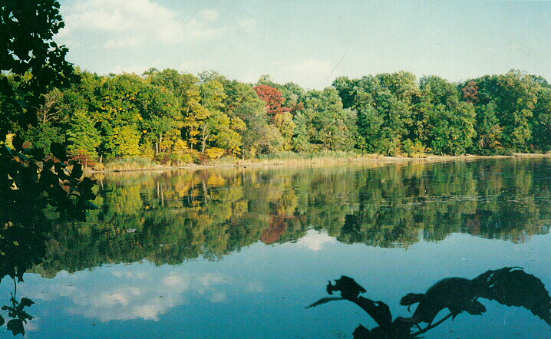
Water

Slide 2
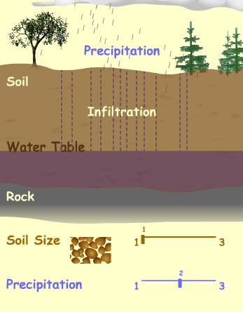
When it rains, water is intercepted by natural vegetation
Water then infiltrates the soil

Slide 3
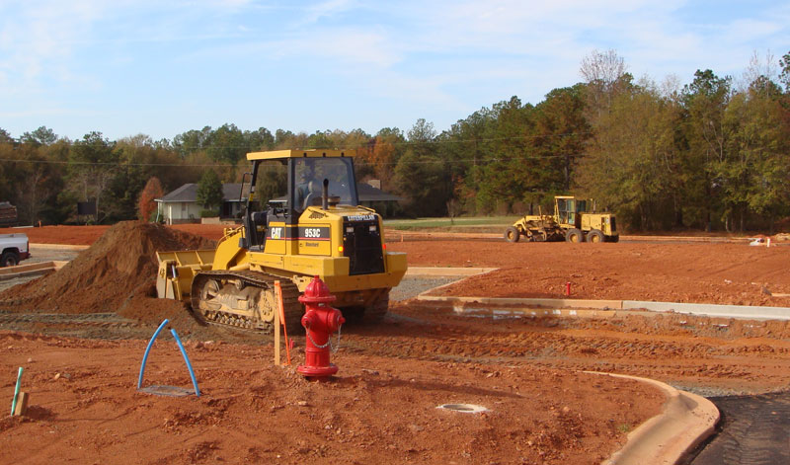
But when soil is disturbed and natural vegetation removed

Slide 4
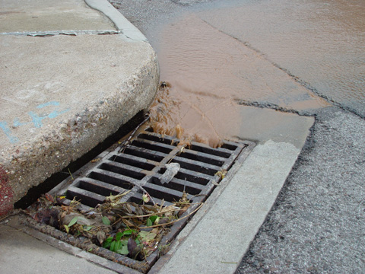
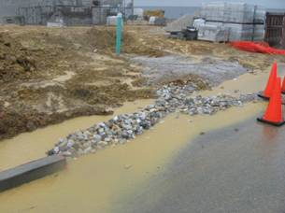
Water becomes runoff
Water runs across the earth’s surface to the lowest points, picking up nutrients, sediment, and toxins

Slide 5
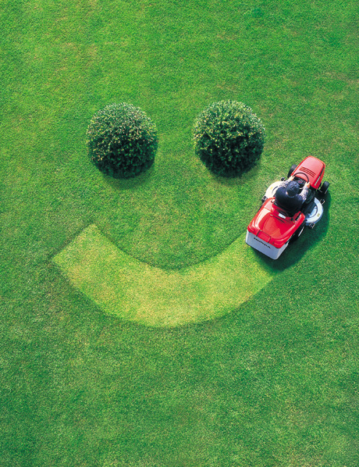
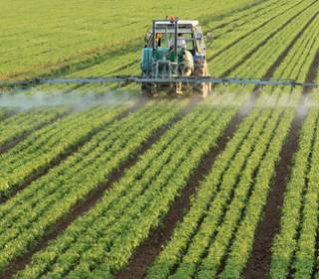
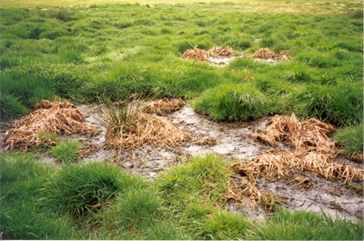
Nutrients
Examples
Fertilizer from happy lawns
Fertilizer from farms
Failing septic systems

Slide 6
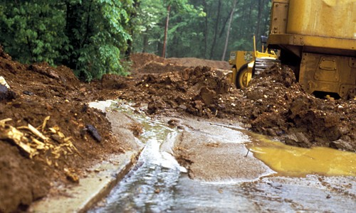
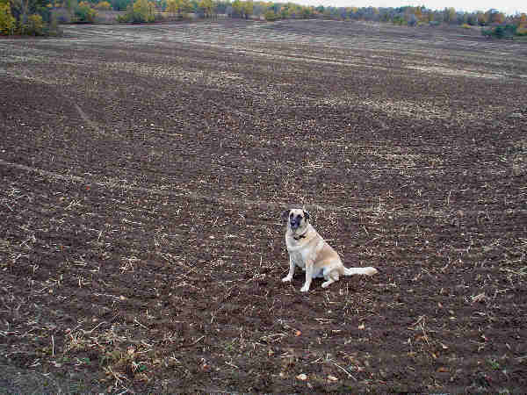
Sediments
Examples
Bare earth from farm fields in winter
Bare earth from development sites

Slide 7
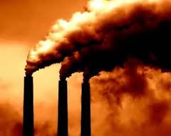
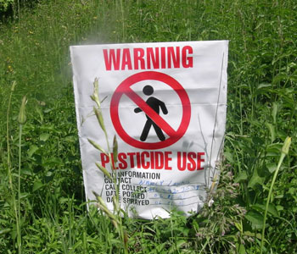
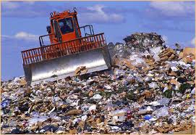
Toxins
Examples of Heavy Metals
Air Pollution
Old, unlined Landfill leachate
Pesticides

Slide 8
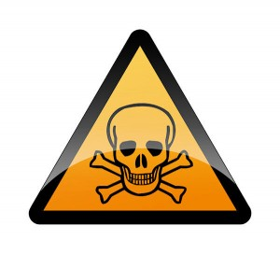
The amount of nutrients, sediment, and toxins currently found in our water runoff is very bad for our natural systems

Slide 9
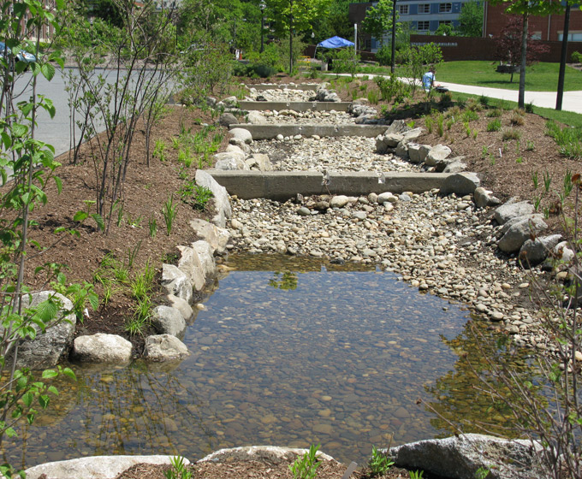
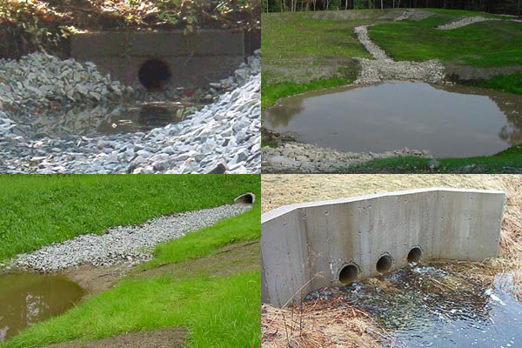
Storm Water Management
Main Goals
Slow runoff
Filter out pollutants
Protect natural waterways
What it looks like:
“Soft” Drainage Structures
Ponds
Swales
Wetlands
“Hard” Drainage Structures
Pipes
Concrete channels

Slide 10
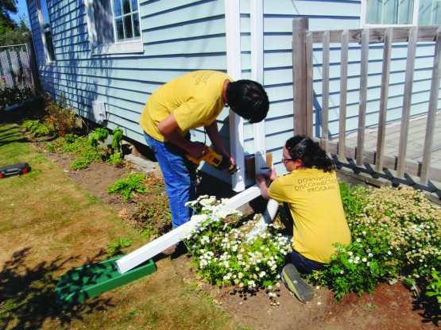
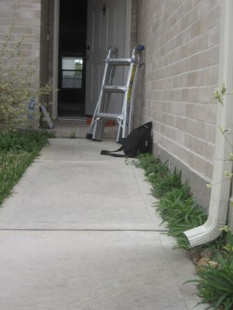
SWM at Home
Do
Point downspouts towards lawn or gardens
Use gravel or porous pavers for patios
Build walking paths along natural contours
Plant ground covers or spread mulch where grass won’t grow
Don’t
Point downspouts towards driveway or sidewalks
Use poured concrete for patios
Build walking paths perpendicular to natural contours
Allow bare earth to remain uncovered

Slide 11
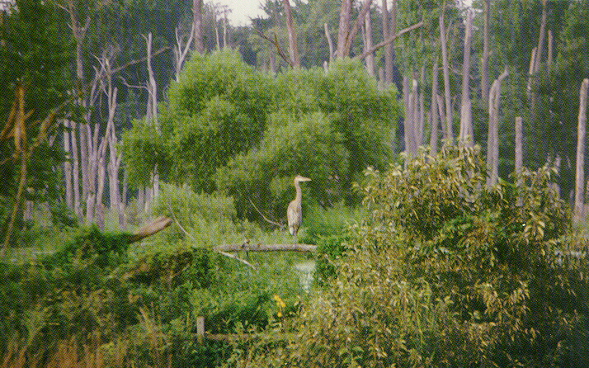
Chesapeake Bay Critical Area Program
Working to Save the Bay
Harford County, Maryland

Slide 12
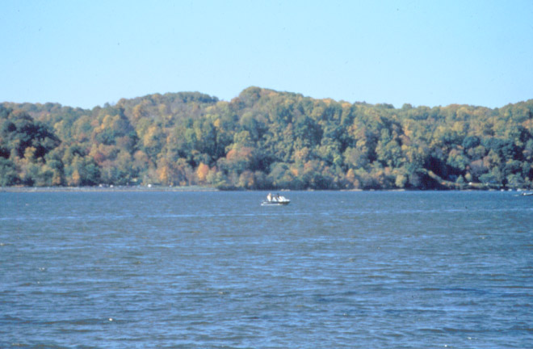
Why is there a Chesapeake Bay Critical Area Program ?
To help protect and conserve wildlife habitat and improve the water quality of the Chesapeake Bay watershed.
To ensure that construction and other land use activities near tidal waters are done in a way that minimizes impacts to the Bay.

Slide 13
What is the Chesapeake Bay Critical Area Program?
A local program required by State law. (Just updated in February 2011).
http://www.harfordcountymd.gov/PlanningZoning/Download/1168.pdf
Applies to all land within 1,000 feet of tidal waters and tidal wetlands along the Bay.

Slide 14
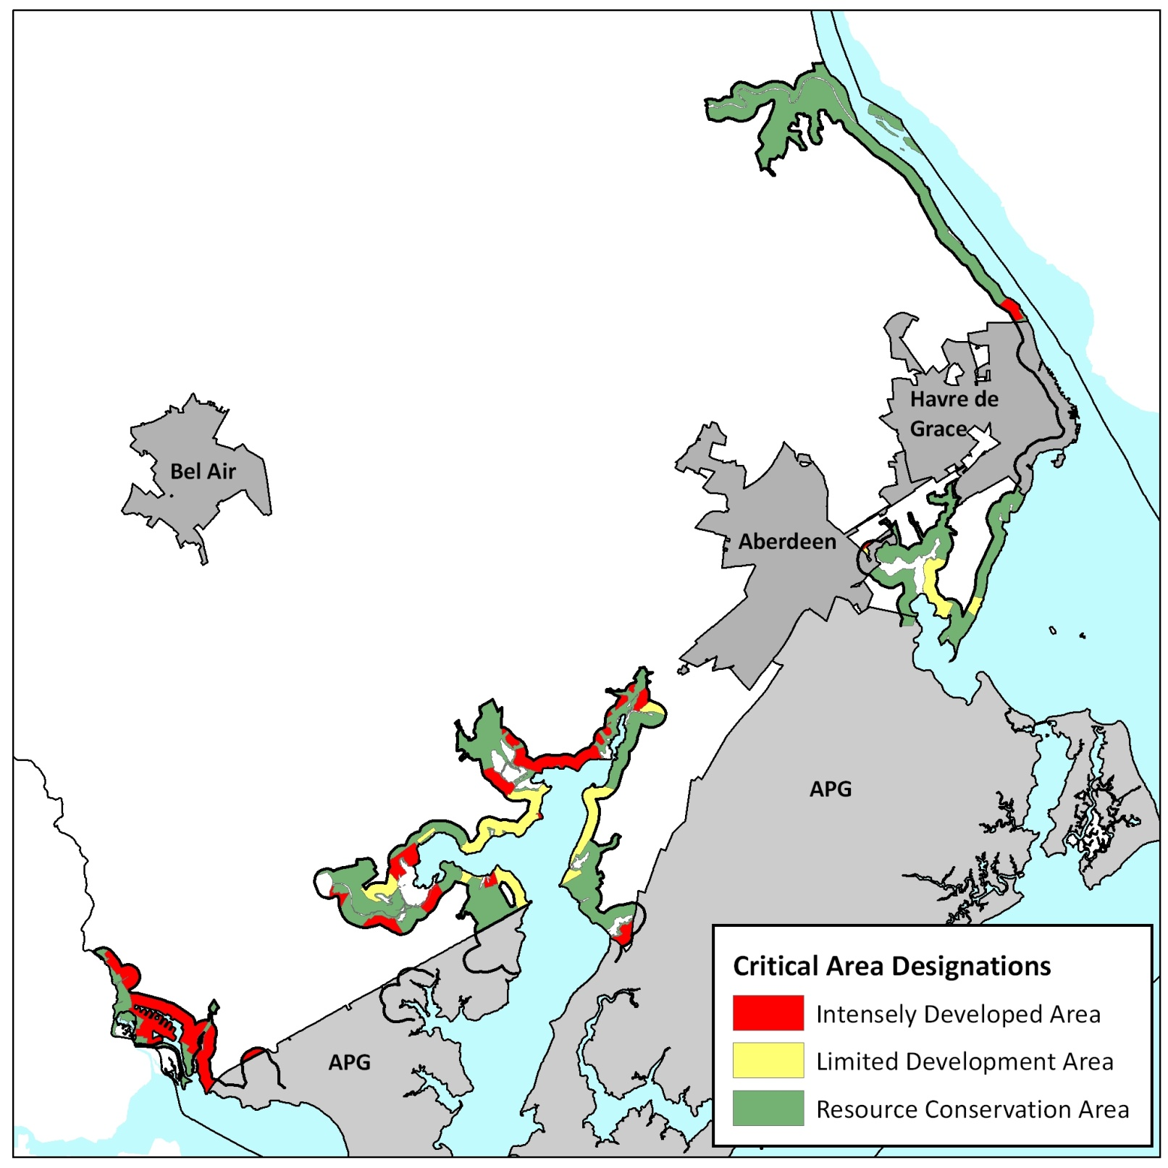
Area?
Where is the Critical Area
in Harford County?

Slide 15
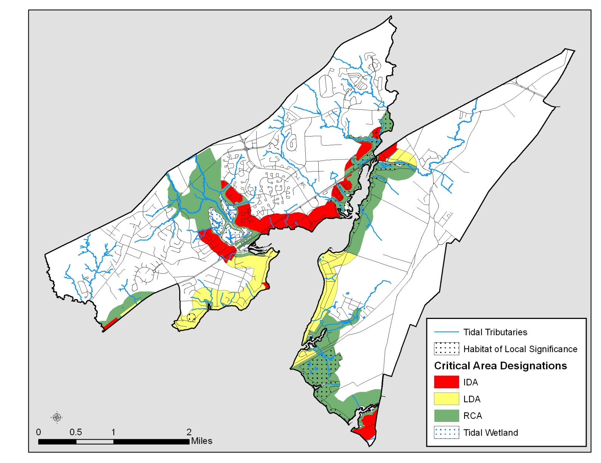
What do the different colors mean?
The Critical Area is divided into three land use management areas based on the existing land use as of December 1st, 1985:
Red – IDA
Yellow – LDA
Green - RCA

Slide 16
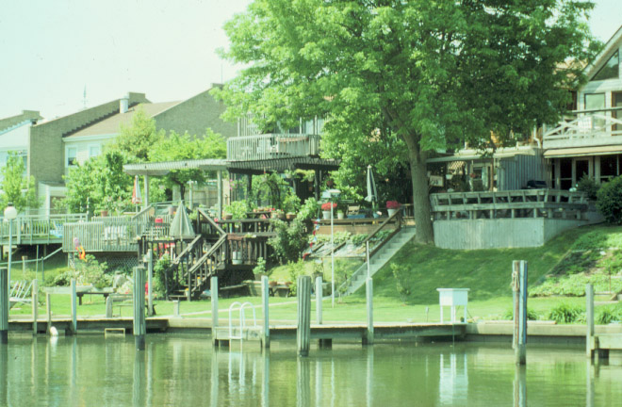
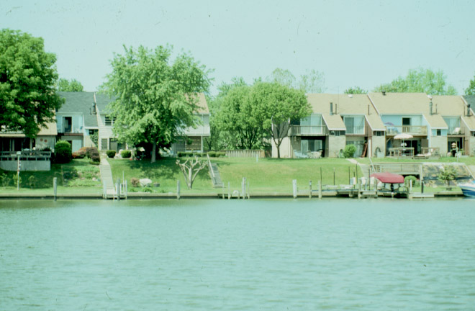
What is an Intensely Developed Area (IDA)?
An area that was largely developed prior to December 1, 1985.
An area served by public water and sewer.
An area where little natural habitat exists.

Slide 17
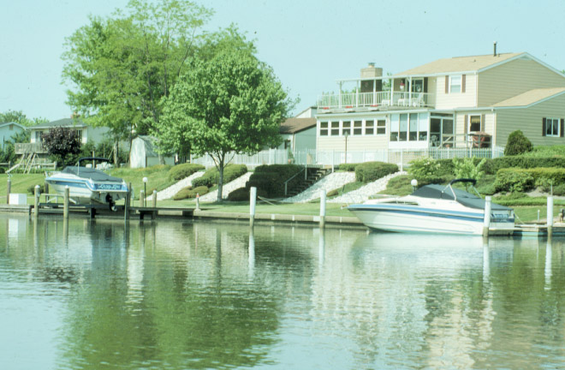
What can I do in the IDA?
Additional development is ok.
Water quality must be improved with a 10% nutrient reduction
Habitat areas must be protected.

Slide 18
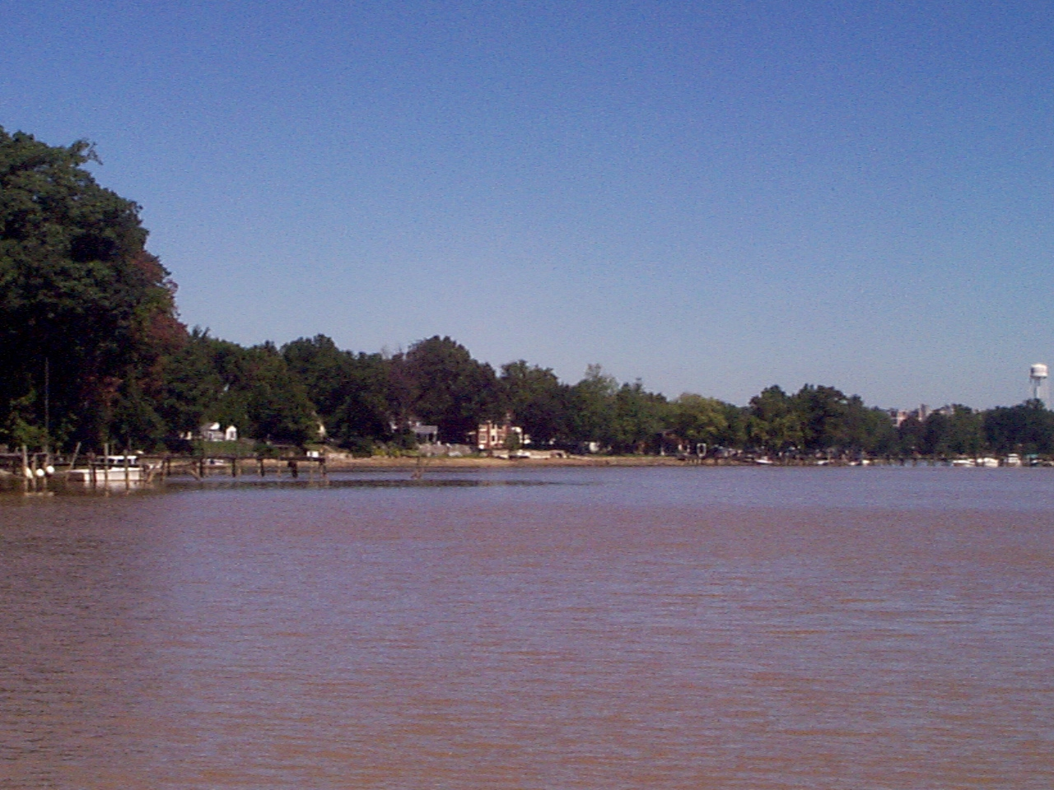
What is a Limited Development Area (LDA)?
It is an area that has some development.
It has areas of natural plant and wildlife habitat.

Slide 19
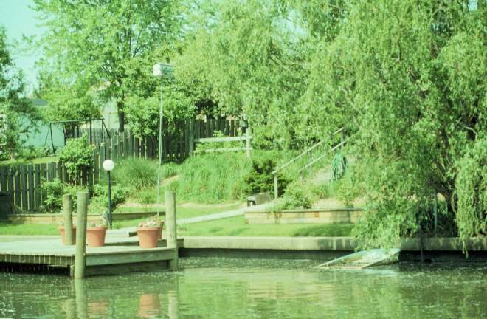
What can I do in the LDA?
  New development is ok.
  Impervious surfaces must be limited (now referred to as lot coverage).
  Water quality must be maintained.
  Plant and wildlife habitat must be protected.
  Clearing of forest and developed woodlands is limited.

Slide 20
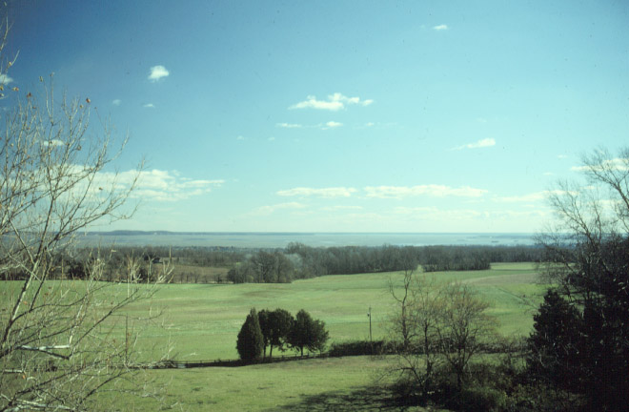
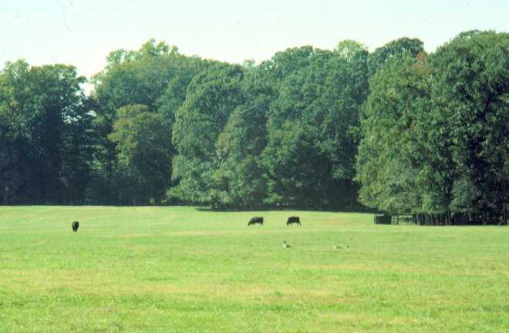
What is the Resource Conservation Area (RCA)?
An area that is largely undeveloped.
Natural resource activities such as agriculture and forestry are the primary land uses.

Slide 21
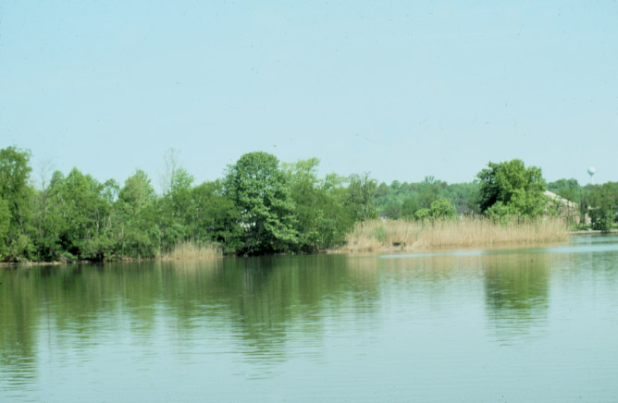
What can I do in the RCA ?
New development cannot exceed 1 house per 20 acres.
Development must address water quality and habitat protection.
Agriculture, Forestry, and other resource uses must also help protect water quality and habitats.

Slide 22
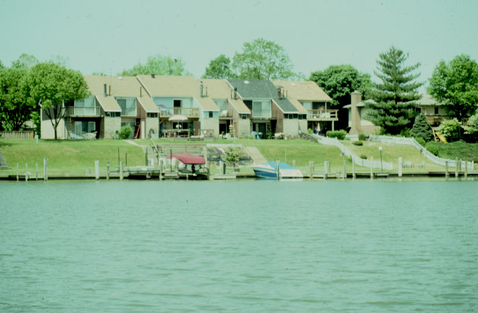
Does this program apply to me if I want to add a deck, shed or pool?
Yes - If your property is in the Critical Area:
There may be a limit on the amount of new development that can occur (lot coverage in LDA & RCA, Buffer).
Native Plantings will be required.
Check with the Department of Planning and Zoning for specific details.

Slide 23
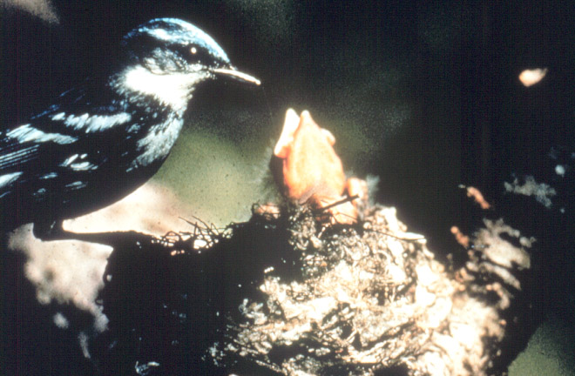
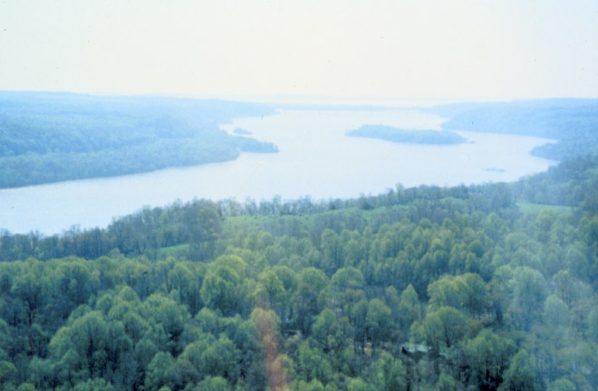
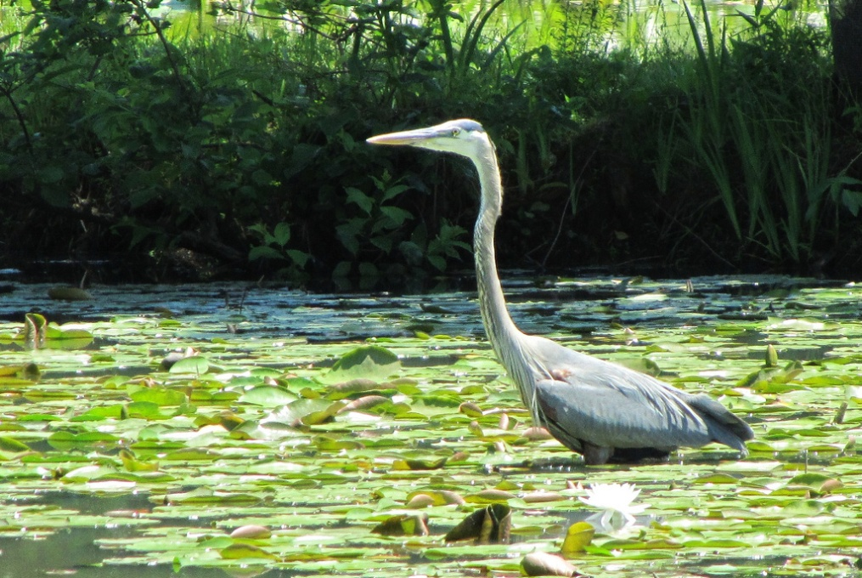
What are Habitat Protection Areas (HPA)?
HPAs are sensitive areas that help protect water quality and provide wildlife habitat.
Five HPAs are included in the CA Program. These are:
  The Critical Area Buffer
  Non-tidal wetlands
  Habitats of Threatened & Endangered Species
  Habitats of Local Significance
  Anadromous Fish Waters

Slide 24
What is the Critical Area Buffer?
It is the first 100 feet from the edge of tidal waters or tidal wetlands.
No disturbance to the Critical Area Buffer is allowed.
Individual trees can only be removed if they are diseased or if they are in danger of falling and damaging a structure.
Individual trees that are removed must be replaced.

Slide 25
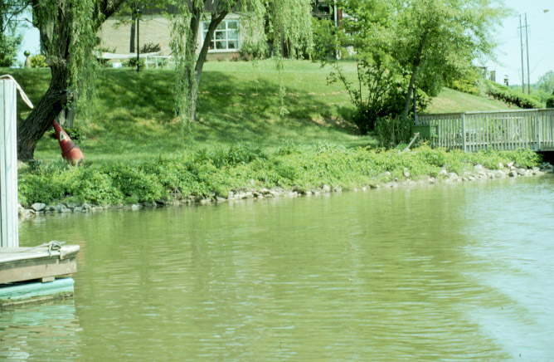
What are Buffer Exempt Areas?
Certain waterfront areas that were developed before 1985.
New development in Critical Area Buffer Exempt Areas is limited (25-foot setback) and mitigation must be provided (2:1).
If new development requires tree removal, the mitigation is based on the size of the canopy of the tree removed. For example, if a tree with a 20 foot radius canopy needs to be removed to make way for a shed, the area of the canopy is calculated as 1,200 square feet.

Slide 26
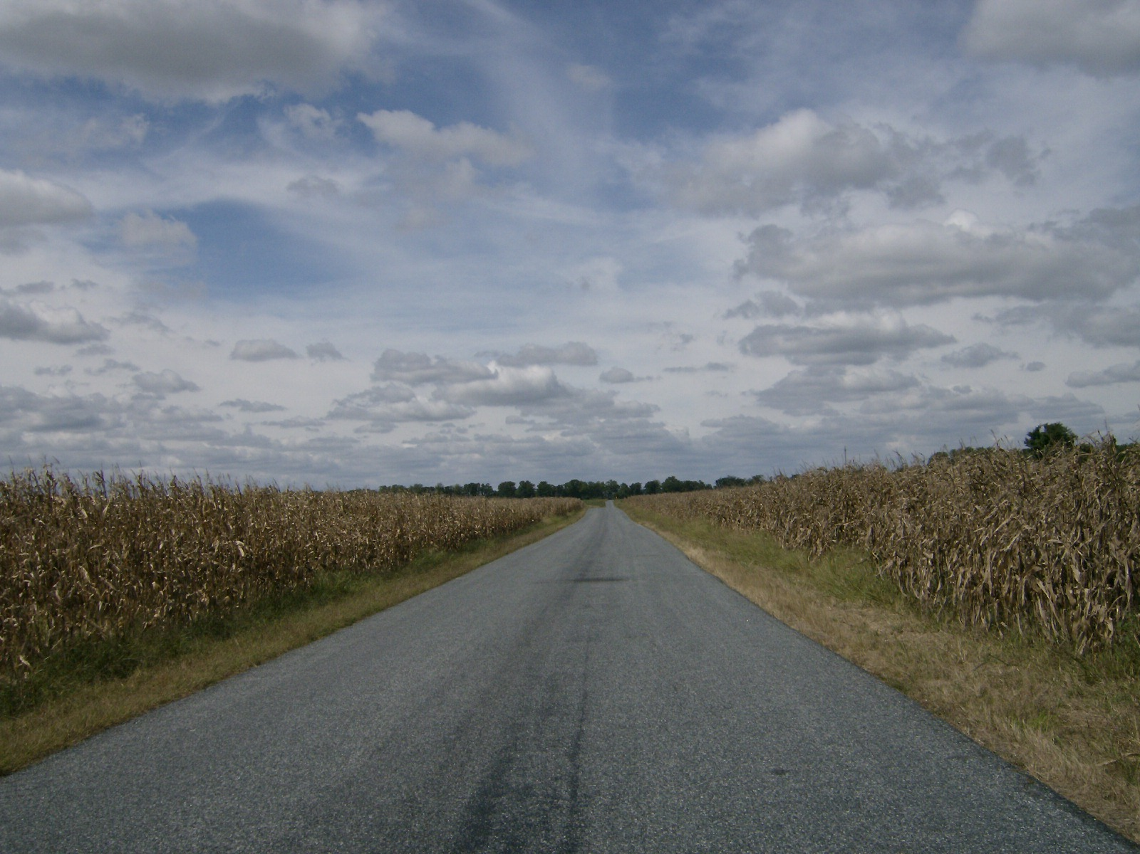
Adventures in the Critical Area

Slide 27
Protecting the 100-foot Critical Area Buffer
Striving to improve the function of the Buffer as part of all development activities
Buffer Management Plan form required to document development activity
Non disturbance area, however, plant maintenance is permitted
Pruning vs. untouched
Reasonable water access is permitted

Slide 28
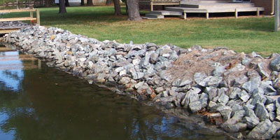
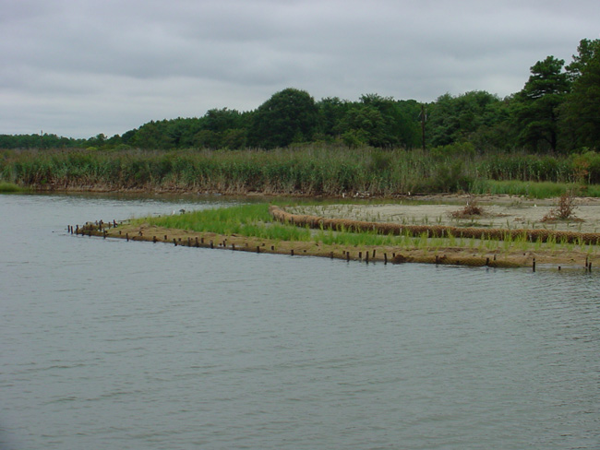
Protecting the 100-foot Critical Area Buffer
Shore Erosion Control - Promoting “Living” Shorelines
Beach Nourishment - replacement of sand
Slope grading/terracing
Marsh establishment - planting tidal wetland plants
Stone rip rap
New bulkheads are not permitted

Slide 29
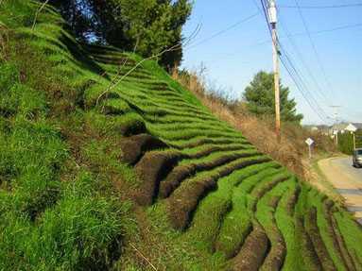
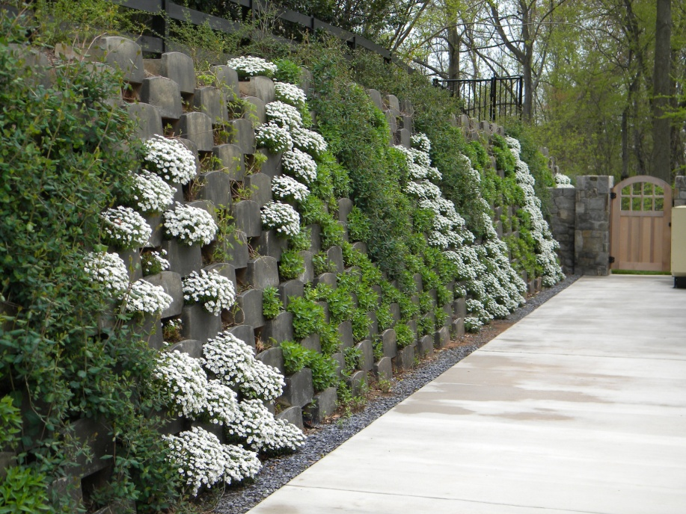
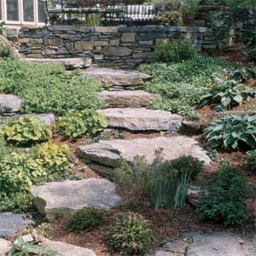
Protecting the 100-foot Critical Area Buffer
Slope stabilization – Promoting “Living” walls
Plants with rocks or blocks

Slide 30
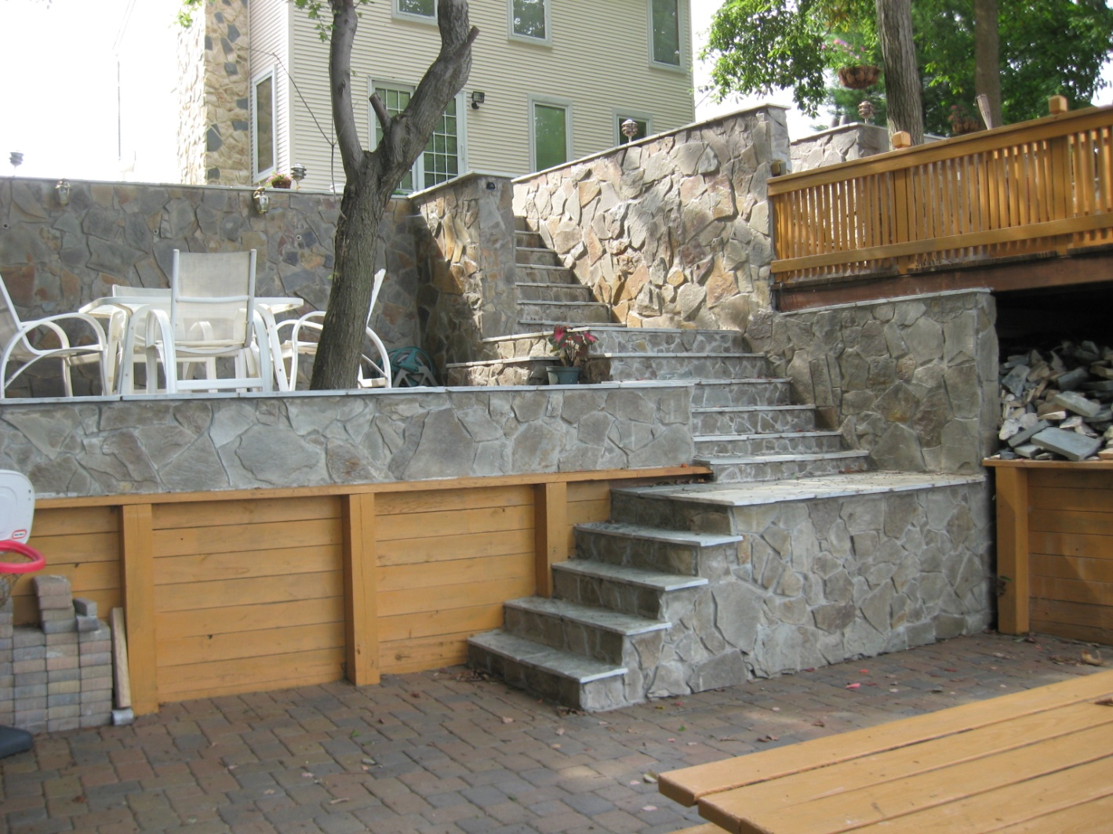
What we’re trying to avoid

Slide 31
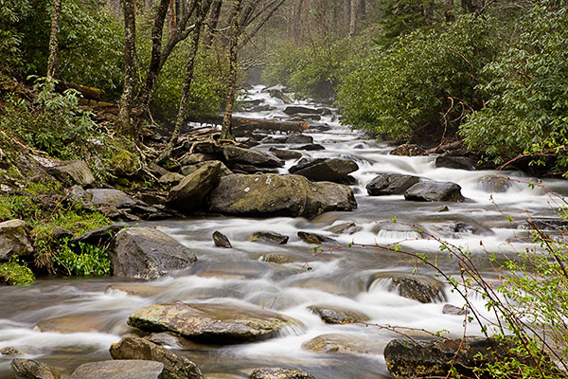
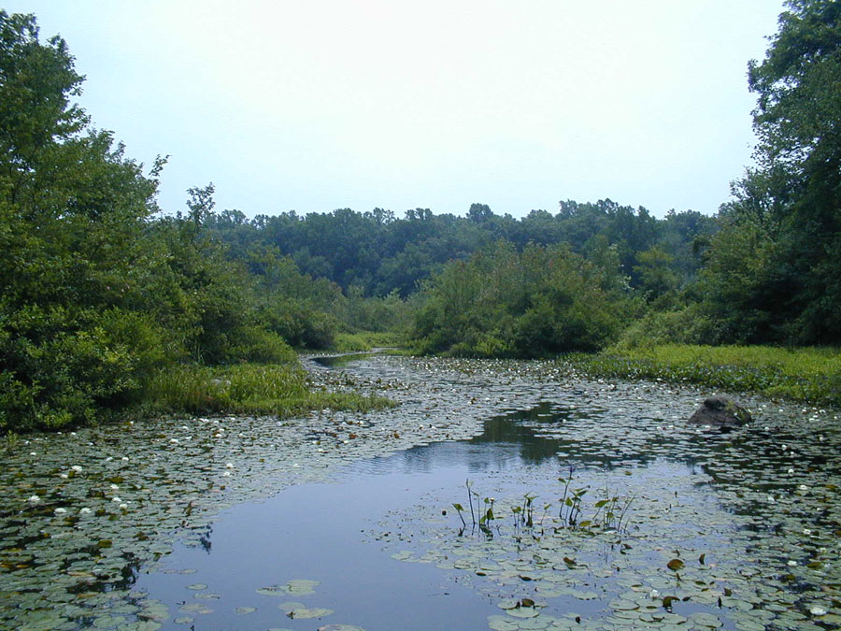
Protecting Streams and Wetlands
Streams receive a 100-foot protective buffer and Wetlands receive a 75-foot protective buffer
Streams and Wetlands
Improve water quality through infiltration
Provide wildlife habitat that is biologically productive
Stores floodwaters that allow for groundwater recharge
Maintain surface water flow in drought

Slide 32
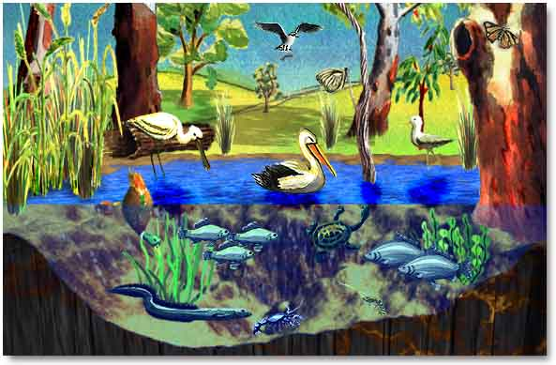
Protecting Streams and Wetlands
Wetlands biology is comparable to tropical rainforests and coral reefs in terms of productivity and the diversity of species they support.
In North America, 50% of bird species nest or feed in wetlands
Likewise, 31% of plant species are found in wetlands

Slide 33
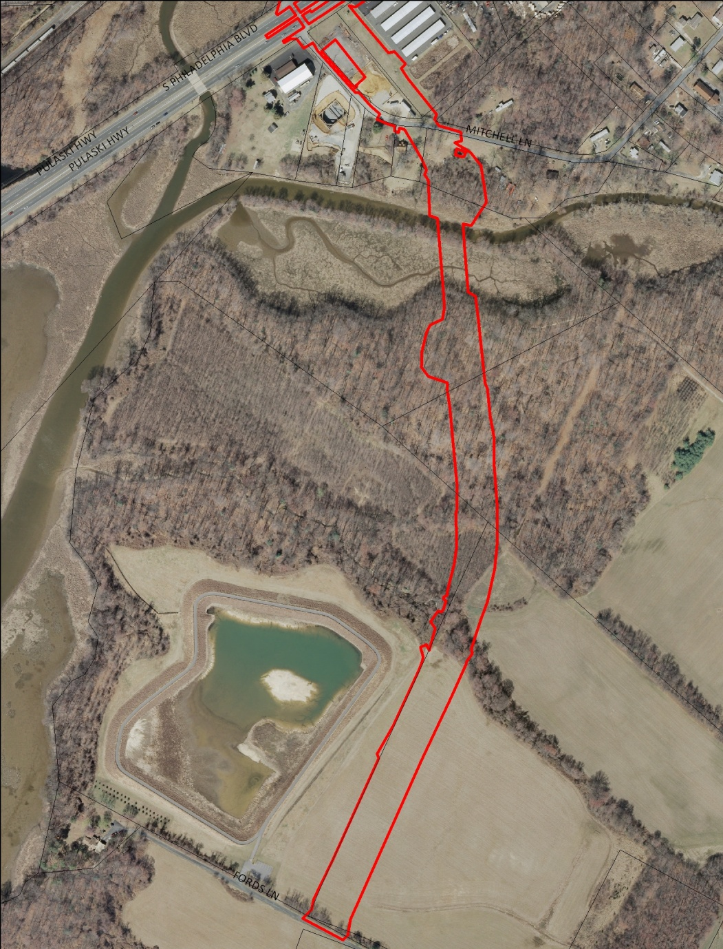
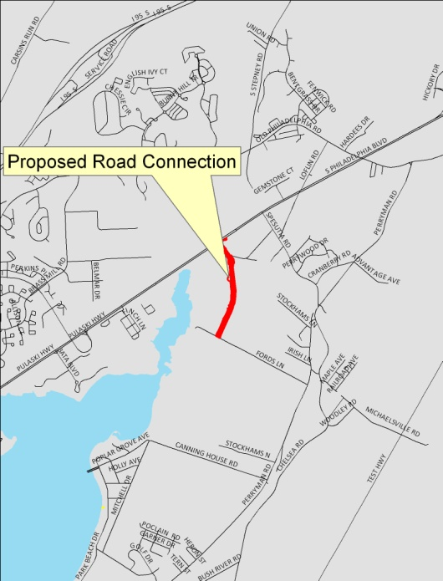
Protecting Streams and Wetlands
As our population continues to grow, new development in the form of houses, roads, water, and sewer lines threatens our sensitive environmental resources.
One recent local example = Perryman Access Road

Slide 34
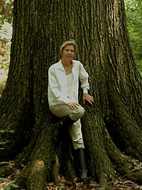
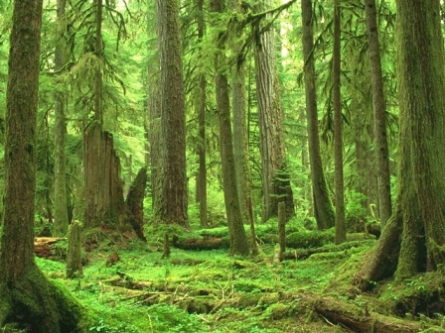
Protecting Forest Resources
Large, contiguous tracts provide habitat for a variety of birds
  A requirement for forest interior dwelling birds to breed
  Some species examples include the Scarlet tanager, Pileated woodpecker, and Barred owl.
“Old growth” forests have high biological productivity
  USDA Forest Statistics
    Maryland has 8 billion trees, but 95% are less than 5 inches in diameter
    Only 2% are greater than 16 inches in diameter
Joan Maloof – recently retired botany professor from Salisbury University
Formed the Old Growth Forest Network www.oldgrowthforest.net

Slide 35
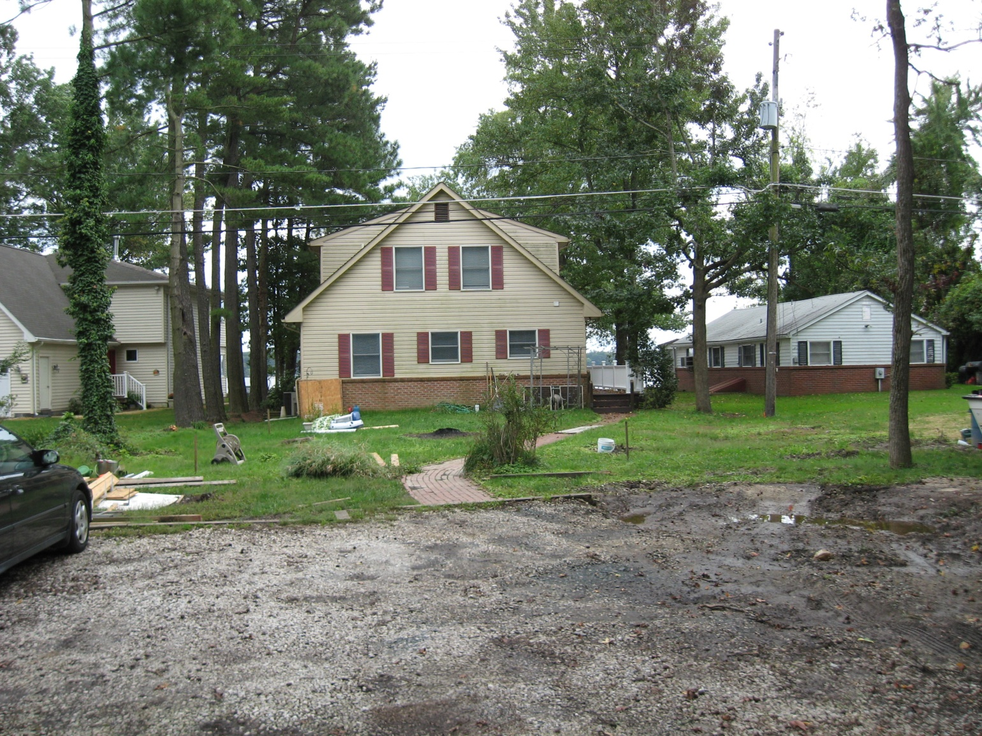
Protecting Forest Resources
Forest and developed woodlands clearing limitation
  30% of existing forest cover, requires 1.5 mitigation ratio
  Example = 6 trees removed, requires replacement with 9 trees

Slide 36

No Net Loss
Forest cover in Maryland has been declining for several decades, due mainly to land development.
  The Forest Conservation Act has only slowed the loss of forest
  Efforts are now under way to ensure there is “no net loss” of forest cover
    Better understanding of the forest resources we have
    Support sustainable use of forests
    Support new tree planting programs
    Improve landowner incentives

Slide 37


Reforestation in the Critical Area
Fee-in-lieu fund
  When new development can’t replace forest on-site
Forest gaps analysis
  Overlay various ecological factors to determine where to prioritize reforestation plantings.
  Factors include:
    Stream and wetland buffers, particularly headwaters
    Forest resource buffers
    Erodible and hydric soils
    Floodplain
    Green Infrastructure
    Habitats of Local Significance

Slide 38
Reforestation in the Critical Area
Top Sites
  Church Creek HLS (Perryman Access Road)
  Home Depot in Abingdon
  Mariner Point Park
  PECO property along Susquehanna River
  Willoughby Beach Landing
  Perryman Park
  Swan Harbor Farm Park
  Constellation property along Bush River
  Tydings Park
  Anita C. Leight Estuary Center

Slide 39

Reforestation in the Critical Area
Anita C. Leight Estuary Center
  26 trees
  24 shrubs
  153
  perennials

Slide 40


Reforestation in the Critical Area
Swan Harbor Farm Park
  212 trees
  90 shrubs
  175 groundcover perennials

Slide 41


Reforestation in the Critical Area
Tydings Park
  167 trees
  73 shrubs

Slide 42



Reforestation Vision for the Critical Area
Maintenance
  No mowing
  No tree tubes
  No stakes
  No herbicides
Will do
  Mulching
  Pruning at 2 year mark
  Weeding to control invasives

Slide 43

Reforestation Vision for the Critical Area
Master Gardener Volunteering Opportunity
  Identifying surrounding native and invasive plants – existing and future projects
  Planting, dividing, and transplanting perennials
  Soil treatments for establishing new trees
  Pruning
  Removing invasive plant species
  Mulching
  Weeding
Master Gardener’s can educate student and adult volunteers on the above gardening practices and then write an article about the experience!
***See Bryan to sign up to participate in an upcoming workshop to be held at the Anita Leight Estuary Center on Saturday April 13, 2013***

Slide 44

Where can I find out more about the Critical Area Program?
Contact: Bryan Lightner
Department of Planning and Zoning
220 S. Main Street
Bel Air, Maryland 21014
Telephone: 410 - 638-3103 ext. 1386
Email: bclightner@harfordcountymd.gov

